Slide 1
Pizza Sales
Hi my name is Himanshu Rawat, in this project I have utilize the SQL queries to solve the problems that were related to pizza sales.

Slide 2
Problems:
Basic :
Retrieve the total number of orders placed.
Calculate the total revenue generated from pizza sales.
Identify the highest-priced pizza.
Identify the most common pizza size ordered.
List the top 5 most ordered pizza types along with their quantities.

Slide 3
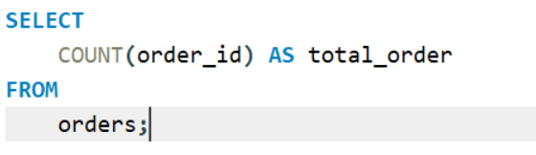

Retrieve the total number of orders placed.

Slide 4
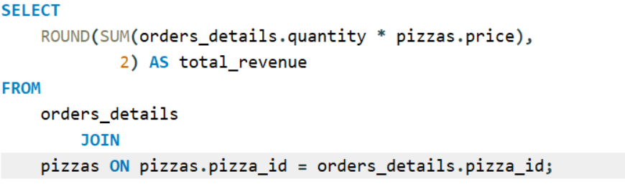

Calculate the total revenue generated from pizza sales.

Slide 5
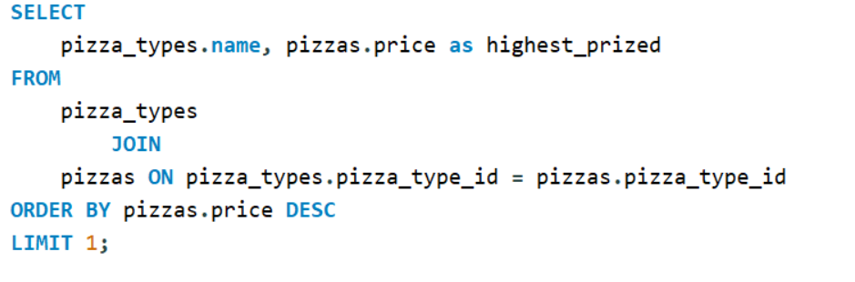
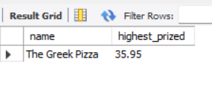
Identify the highest-priced pizza.

Slide 6
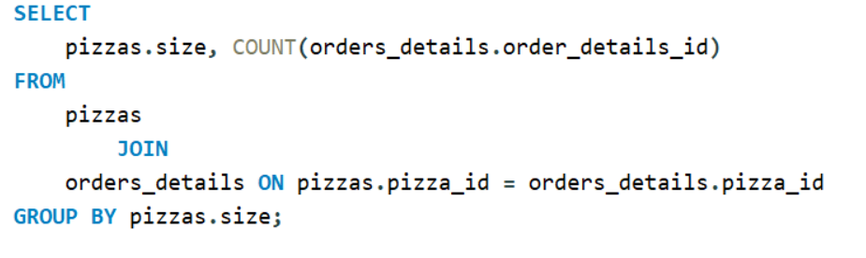
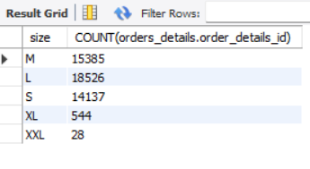
Identify the most common pizza size ordered.

Slide 7
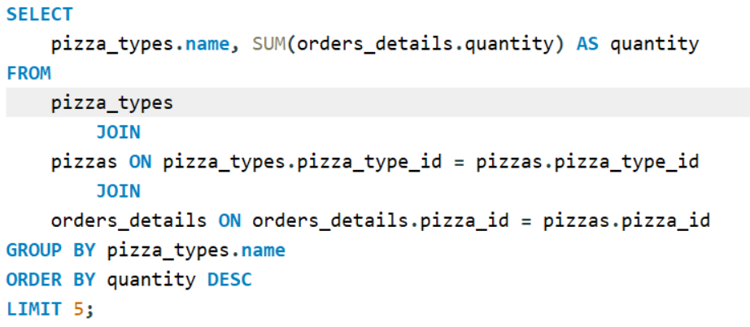
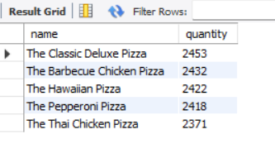
List the top 5 most ordered pizza types along with their quantities.

Slide 8
Problems:
Intermediate :
Join the necessary tables to find the total quantity of each pizza category ordered.
Join relevant tables to find the category-wise distribution of pizzas.
Group the orders by date and calculate the average number of pizzas ordered per day.
Determine the top 3 most ordered pizza types based on revenue.

Slide 9
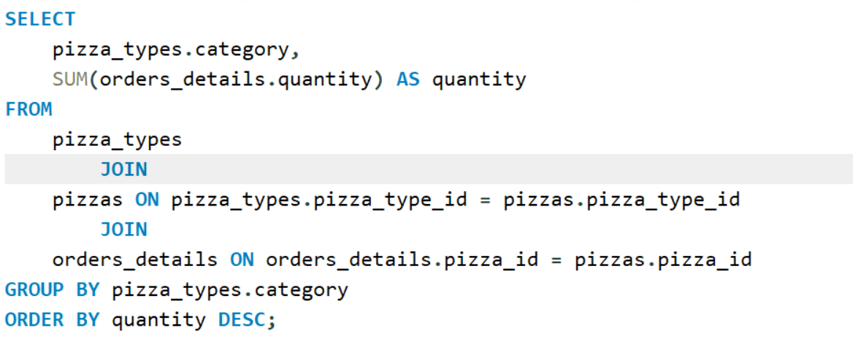
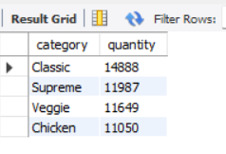
Join the necessary tables to find the total quantity of each pizza category ordered.

Slide 10
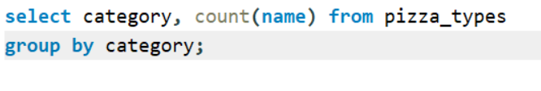
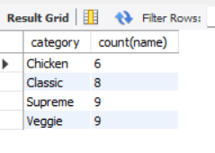
Join relevant tables to find the category-wise distribution of pizzas.

Slide 11
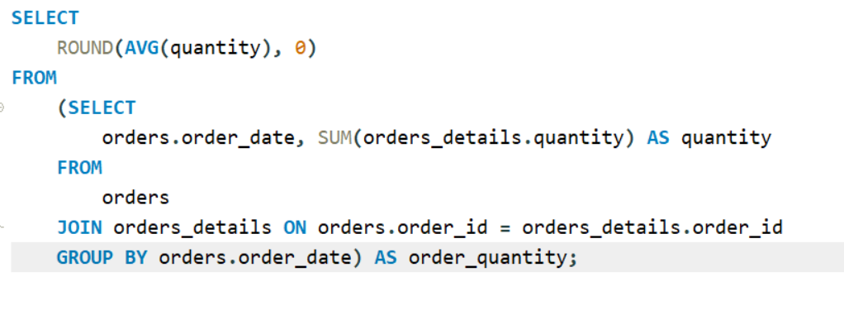
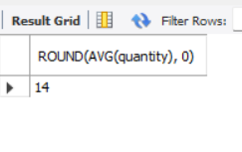
Group the orders by date and calculate the average number of pizzas ordered per day.

Slide 12
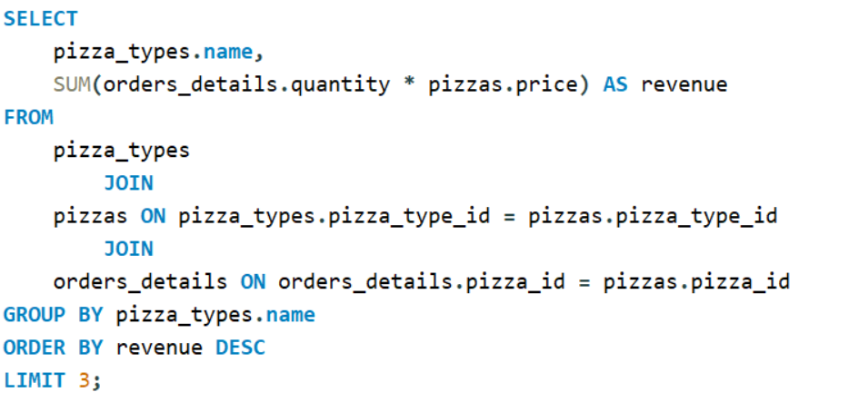
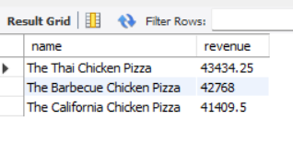
Determine the top 3 most ordered pizza types based on revenue.

Slide 13
Problems
Advanced :
Calculate the percentage contribution of each pizza type to total revenue.
Analyze the cumulative revenue generated over time.
Determine the top 3 most ordered pizza types based on revenue for each pizza category.

Slide 14
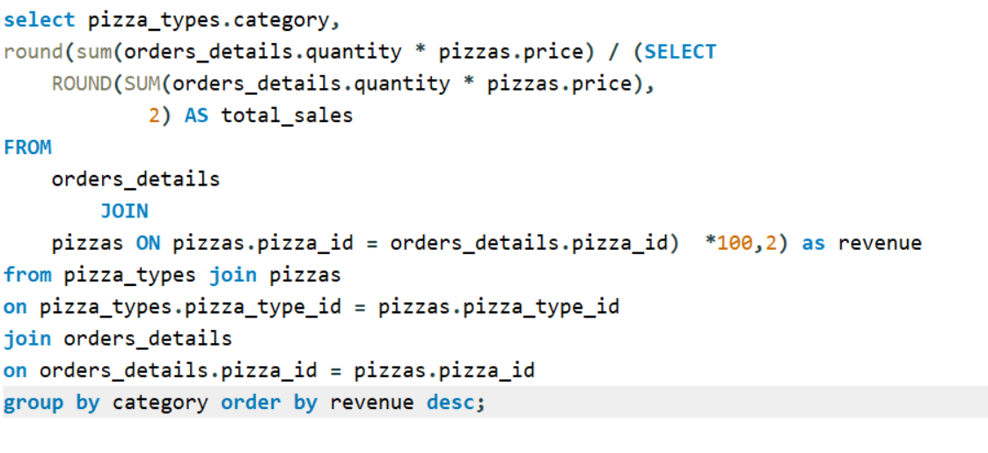
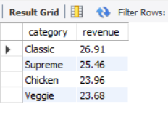
Calculate the percentage contribution of each pizza type to total revenue.

Slide 15
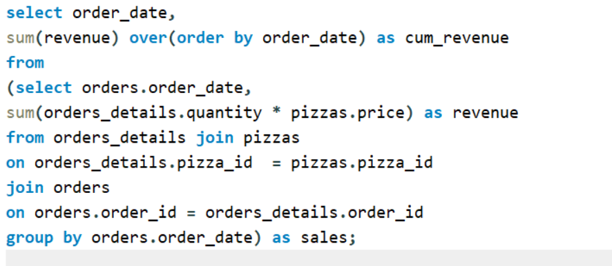
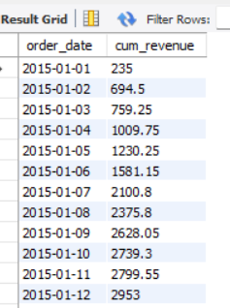
Analyze the cumulative revenue generated over time.

Slide 16
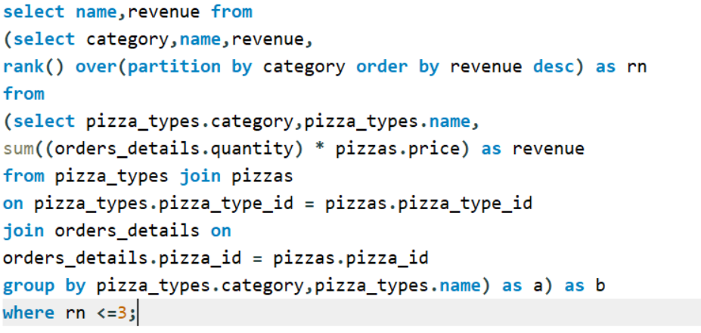
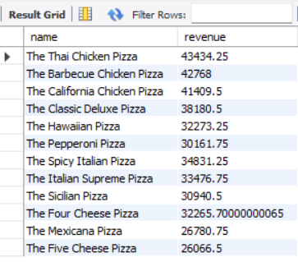
Determine the top 3 most ordered pizza types based on revenue for each pizza category.

